Slide 1
ONLINE VOTING SYSTEM
Submitted by:
Sathvik
Chinmay
Jyoth Kumar
Shravan

Slide 2
Introduction
We are developing an online voting system with the use of database
The main concept of this project is to build a website which should be able to allow people to cast their vote by online
Time saving working load reduced

Slide 3
ABSTRACT
College Online Voting System is a web-based system, it automates the running of elections and surveys online. Users are individually interacting with the system. All user interaction is performed remotely through the user's browser. Before voting user should fill registration form and provide their details. Users using their Register Number, Email and password log in into this system.

Slide 4
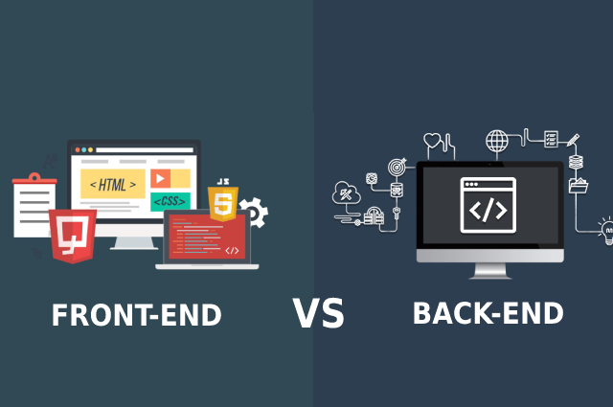
Software Requirements:
Development Tool : PHP
Front-end : HTML , CSS , Java script
Browser : Chrome/Mozilla Firefox
Server : XAMP Server
Database : Mysql

Slide 5
Hardware Requirements:
Device : Windows 10 , Windows 11
Processor: Intel Core i3
20Gb hard disk space
4Gb RAM

Slide 6
Contains:
Voter’s information in database.
Student’s name and Register number
Candidate Register
Student's vote in a database.
Calculation of total number of votes.
Admin Panel
Result

Slide 7
User Characteristics
Every user should be:
Comfortable with Internet Browser.
He must have brief knowledge of voting system.
He must also have basic knowledge of English too.

Slide 8
Advantages
Time saving.
Working load reduced.
Information available at time.
It provide security for the data.

Slide 9

Modules
Home page

Slide 10

About Form

Slide 11
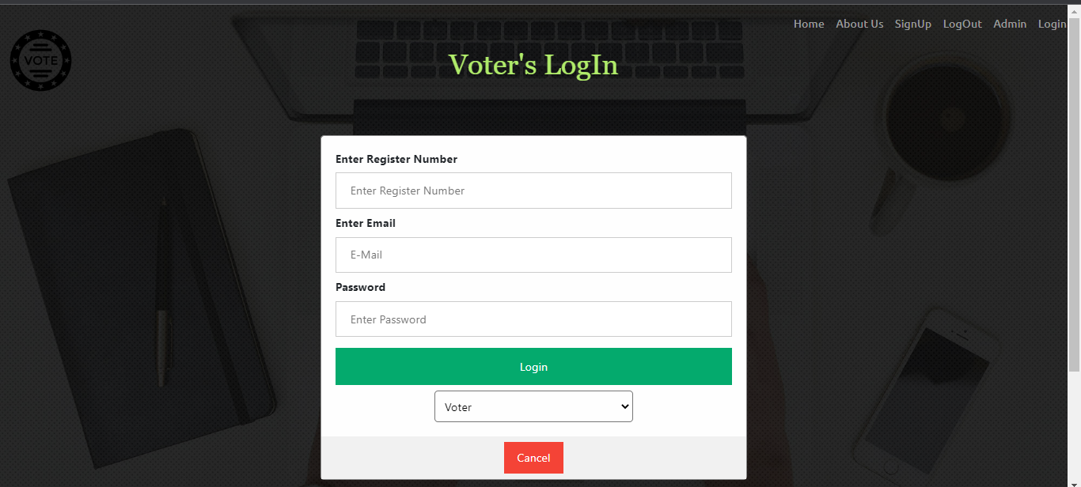
Voter Login

Slide 12
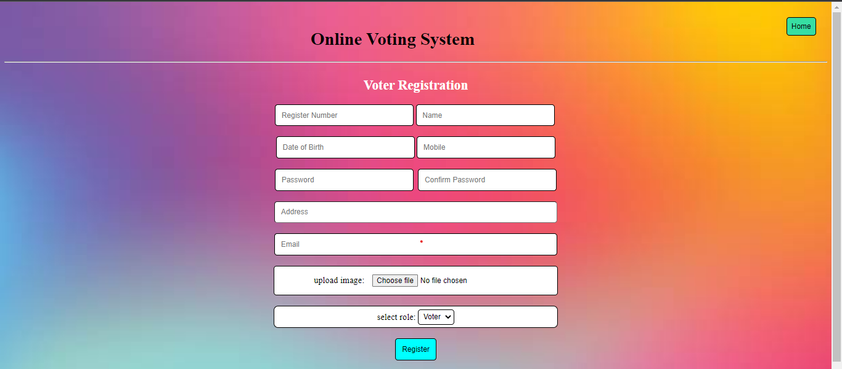
Voter Registration

Slide 13

Admin Login

Slide 14
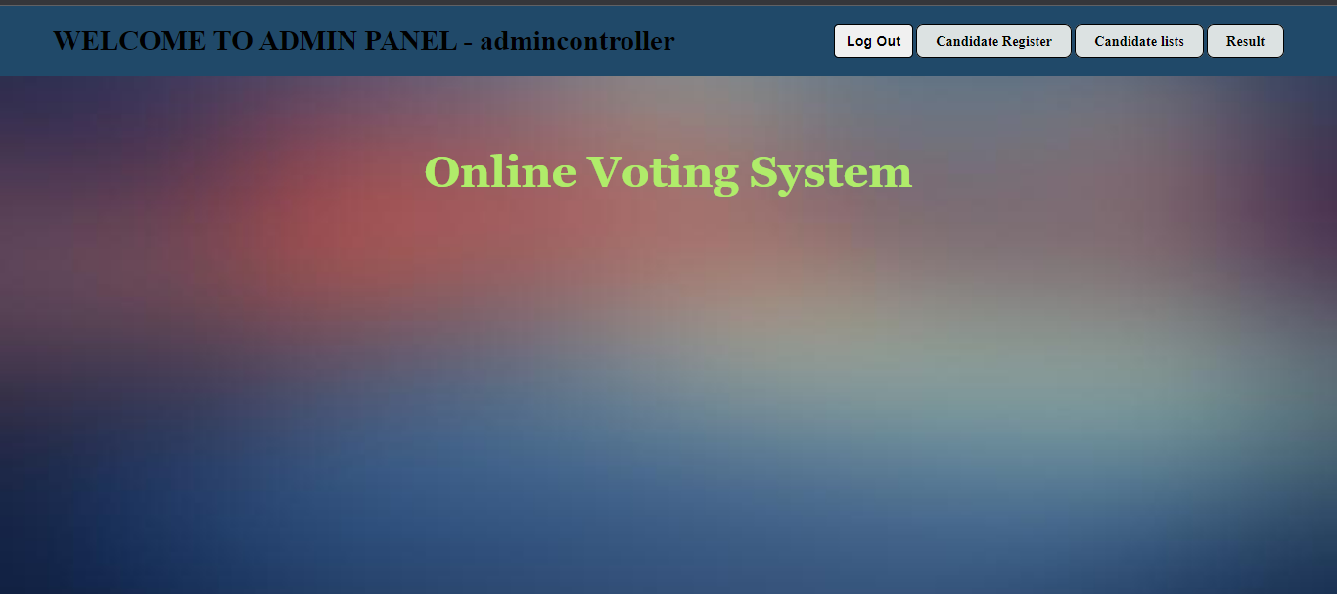
Admin Panel

Slide 15
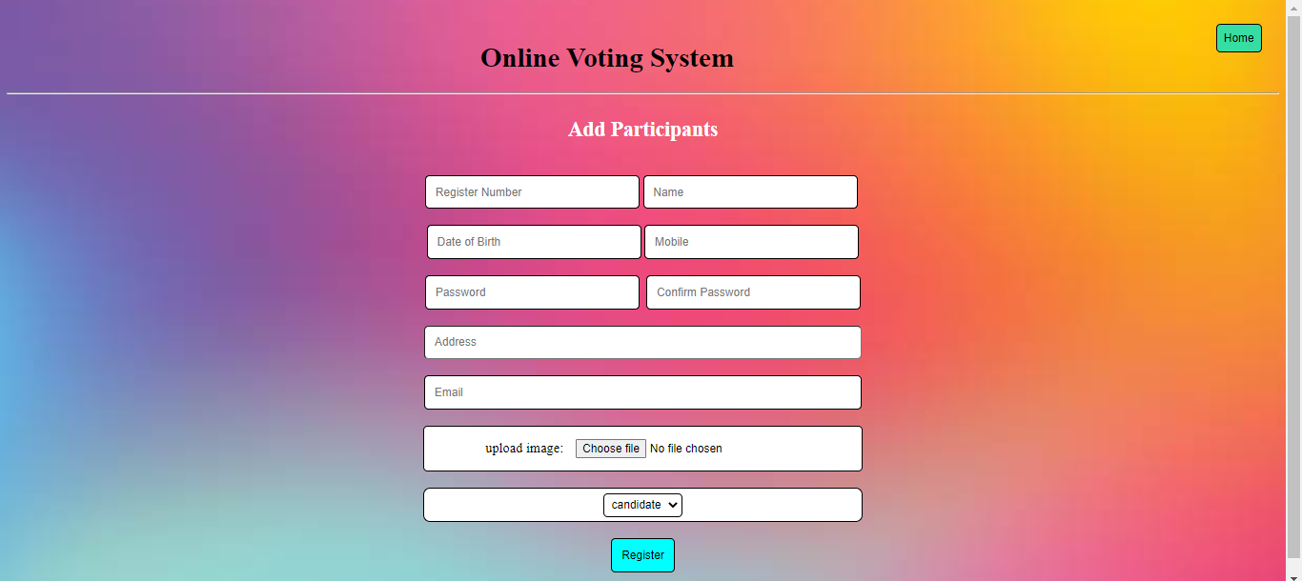
s
Candidate Register

Slide 16
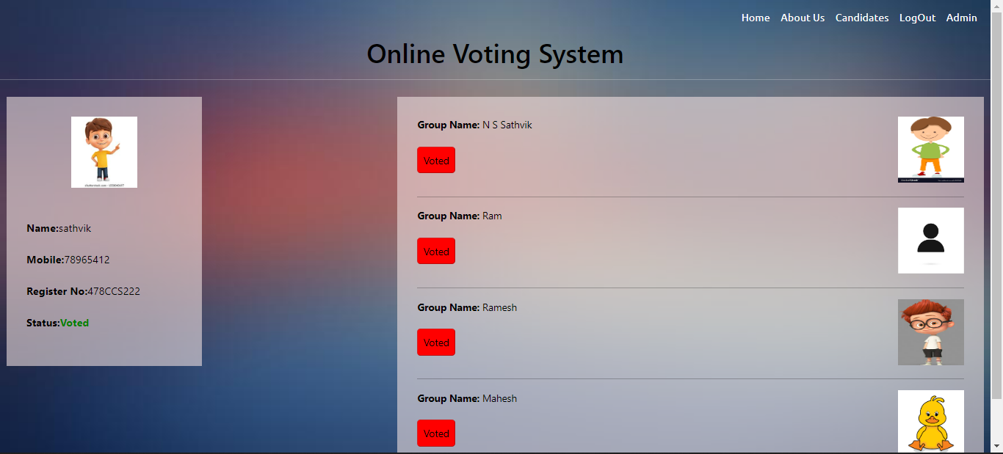
Voting Dashboard

Slide 17
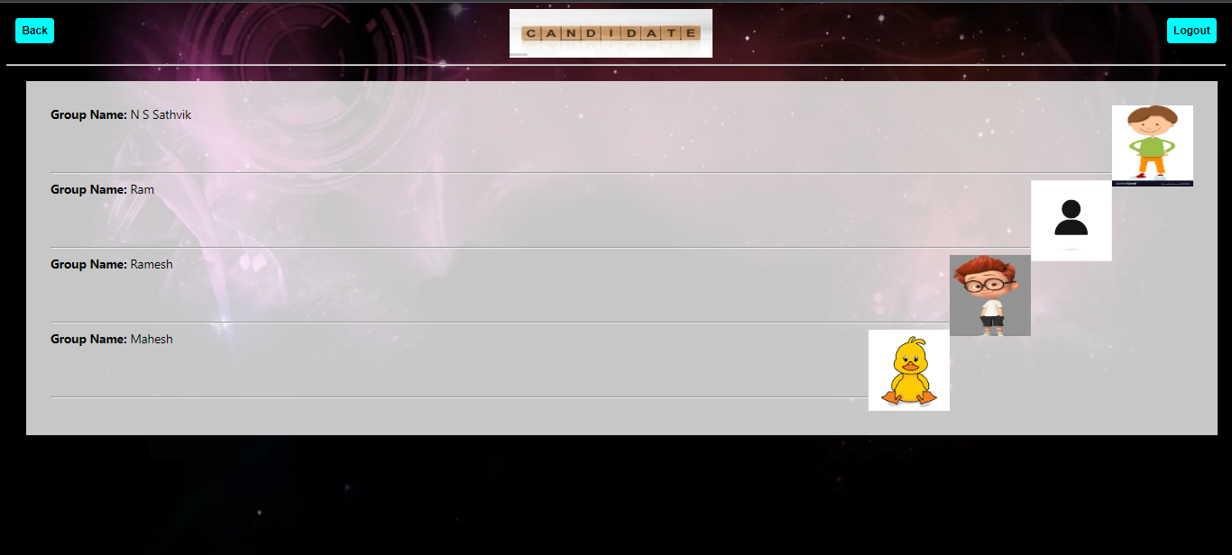
Candidate List

Slide 18
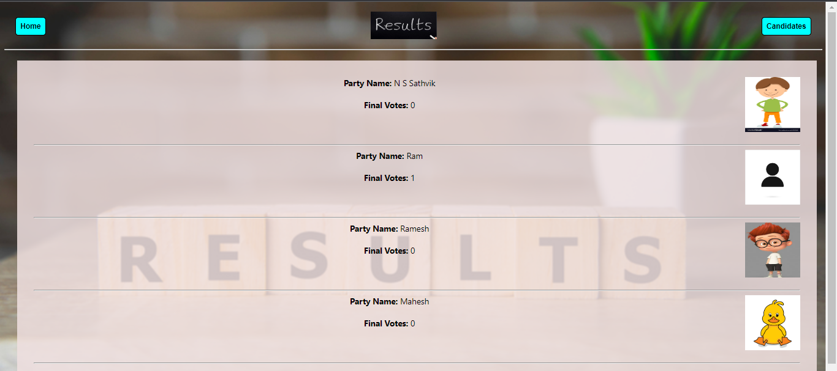
Result Page

Slide 19
Traditional v/s online voting
Traditional:
Take time and human resources
Do not give instant results
Hard to track who voted and who did not
Online voting
Give the instant result
Easy to keep track of voters
Vote using internet from any where

Slide 20
Conclusion:
This Online Voting system will manage the Voter’s information by which voter can login and use his voting rights. The system will incorporate all features of Voting system. Its provide the tools for maintaining voter’s vote to every party and it count total no. of votes of every party. There is a DATABASE which is maintained by the ELECTION COMMISION in which all the names of voter with complete information is stored.

Slide 21
Reference
For PHP
https://www.w3schools.com/php/default.asp
https://www.sitepoint.com/php/
https://www.php.net/
https://codeigniter.com/
For MySQL
https://www.mysql.com/
http://www.mysqltutorial.org
For XAMPP
https://www.apachefriends.org/download.html

Slide 22
Thank You

